Slide 1

HOSPITAL MANAGEMENT SYSTEM
A professional healthcare management solution..!
A GROUP PROJECT BY:
Sk Mohammad - AP23110011178
Sai Puppala - AP23110011172
P Pavan Kumar - AP23110011201
Sk.Abdullah - AP23110011186
Mahaboob Basha - AP23110011216

Slide 2
TABLE OF CONTENTS
Introduction
Project Overview
System Overview
Key Classes
User Options
Code Structure
File Handlings
Testing and Results
Future References
Conclusion
References

Slide 3
Introduction….
Project Background
Healthcare facilities require efficient management systems to handle the increasing complexity of patient care and administrative tasks. This project addresses these needs through a computerized management system.
Problem Statement
Traditional hospital management faces several challenges:
Manual record keeping
Appointment scheduling conflicts
Inefficient patient record retrieval
Difficulty in tracking doctor availability
Risk of data loss or mismanagement

Slide 4

Project Overview….
Purpose: “A system designed to streamline hospital operations and enhance patient care”.
Core Features:
Patient and doctor management
Appointment scheduling
Easy data retrieval and storage
Objective: "To develop a comprehensive hospital management system using OOPS concepts in C++”

Slide 5
System(code) Overview….
Doctor
Patient
Hospital Management System
Appointment
File Handling

Slide 6


Key Classes….
Patient class
Doctor
Class
Appointment
class
Attributes
Attributes
Attributes
string name;
int age;
string address;
string contact;
string bloodGroup;
string medicalHistory;
string name;
int Experience;
string Specialization;
string Availability;
Patient patient;
Doctor doctor;
string date;
string time;
Member Function(s)
Member Function(s)
Member Function(s)
void displayPatientInfo()
void displayDoctorInfo()
void displayAppointmentInfo()

Slide 7
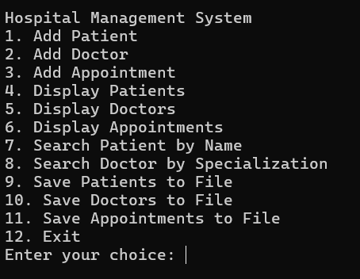
User Options….
Add Patient //adds a doctor
Add Doctor // adds a patient
Add Appointment // adds an appointment
Display Patients // retrieves patient data
Display Doctors // retrieves doctors data
Display Appointments // retrieves App data
Search Patient by Name// search patient
Search Doctor by Specialization //search doctor
Save Patients to File // save patients
Save Doctors to File // save doctors
Save Appointments to File // save app
Exit // exits the program

Slide 8
Code Structure(snippet)….
A Overview of this project we did using C++ language:
Beginning of this code we used nine header files i.e,
#include <fstream>
#include <iomanip>
#include <iostream>
#include <regex>
#include <sstream>
#include <string>
#include <algorithm>
#include <cctype>
#include <vector>

Slide 9
Provided the Driver code in the main function
int main() {
vector<Patient> patients; vector<Doctor> doctors; vector<Appointment> appointments;
// Load data from files
loadPatientsFromFile(patients, "patients.txt");
loadDoctorsFromFile(doctors, "doctors.txt");
loadAppointmentsFromFile(appointments, "appointments.txt", patients, doctors);
int choice;
do {
cout << "\nHospital Management System\n";
cout << "1. Add Patient\n";
cout << "2. Add Doctor\n";
cout << "3. Add Appointment\n";
cout << "4. Display Patients\n";
cout << "5. Display Doctors\n";
cout << "6. Display Appointments\n";
cout << "7. Search Patient by Name\n";
cout << "8. Search Doctor by Specialization\n";
cout << "9. Save Patients to File\n";
cout << "10. Save Doctors to File\n";
cout << "11. Save Appointments to File\n";
cout << "12. Exit\n";
cout << "Enter your choice: ";
cin >> choice;
cin.ignore(); // Clear the newline from the input buffer

Slide 10
switch (choice) {
case 1:
addPatient(patients);
break;
case 2:
addDoctor(doctors);
break;
case 3:
addAppointment(patients, doctors, appointments);
break;
case 4:
displayPatients(patients);
break;
case 5:
displayDoctors(doctors);
break;
case 6:
displayAppointments(appointments);
break;
case 7: {
string searchName;
cout << "Enter patient name to search: ";
getline(cin, searchName);
searchPatientByName(patients, searchName);
break;
}

Slide 11
case 8: {
string searchSpecialization;
cout << "Enter doctor specialization to search: ";
getline(cin, searchSpecialization);
searchDoctorBySpecialization(doctors, searchSpecialization);
break;
}
case 9:
savePatientsToFile(patients, "patients.txt");
break;
case 10:
saveDoctorsToFile(doctors, "doctors.txt");
break;
case 11:
saveAppointmentsToFile(appointments, "appointments.txt");
break;
case 12:
cout << "Exiting...\n";
break;
default:
cout << "Invalid choice.\n";
}
} while (choice != 12);
// Save data before exiting
savePatientsToFile(patients, "patients.txt");
saveDoctorsToFile(doctors, "doctors.txt");
saveAppointmentsToFile(appointments, "appointments.txt");
return 0;
}

Slide 12
In the above code we have created different functions to perform different operations.
They are:
void addPatient();//it adds a new patient details
void addDoctor();//it adds a new doctor details
void addAppointment();//it adds new appointments
void displayPatients();//it display the details of all patients
void displayDoctors();//it display the details of all doctors
void displayAppointments();//it display the appointments
void savePatientsToFile();//it saves the new patient details to existing file
void loadPatientsFromFile();//it loads the details from files to code
void saveDoctorsToFile();//it saves the doctor details to files
void loadDoctorsFromFile();//it loads the doctors details form files to code
void saveAppointmentsToFile();//to take new appointments and saves it
void loadAppointmentsFromFile()
bool isValidTime();//it checks the time entered by patient is valid or not ex:25.15 is not valid
bool isValidDate();//it checks the date entered by patient is valid or not ex:30-2-2020 it is not valid
void searchPatientByName();//it searches the details of the patients by their names
void searchDoctorBySpecialization()//it shows the no of doctors
available by their specialization

Slide 13
File Handlings….
Process:
Data Storage & Retrieval: Information on patients, doctors, and appointments is saved to files to ensure data persistence.
Efficient Management: On program startup, data is loaded from files, allowing seamless continuation of records.
// Save patients to file
ofstream outfile("patients.txt"); for (const auto &patient : patients) { outfile << patient.name << "," << patient.age << endl;
// Write patient data } // Load patients from file
ifstream infile("patients.txt"); while (getline(infile, line)) { stringstream ss(line); getline(ss, name, ','); // Read patient data }

Slide 14
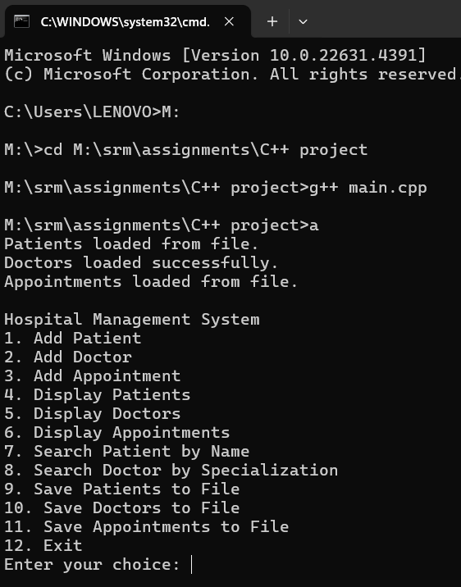
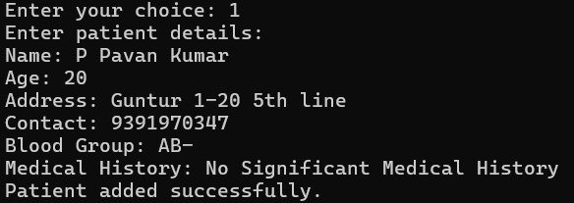
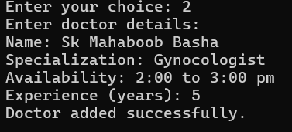
Sample Outputs….
OUTPUT
ADD PATIENT
ADD DOCTOR

Slide 15
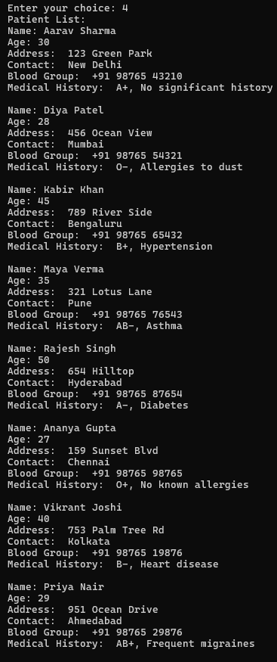
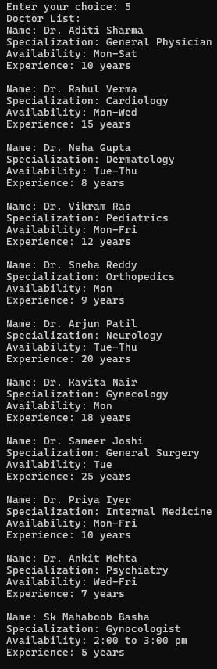
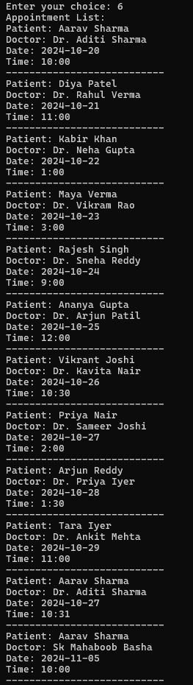
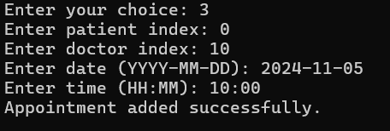
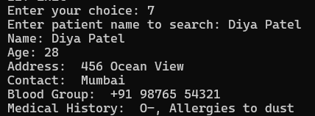
DISPLAY Appointments
DISPLAY PATIENTS
DISPLAY DOCTORS
ADDAppointments
SEARCH PATIENT

Slide 16
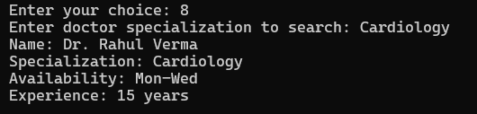
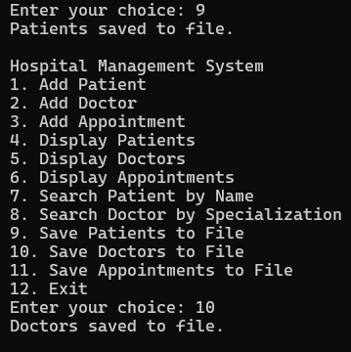

SEARCH DOCTOR
STORING
COMPILED SUCCESSFULLY

Slide 17
Future Enhancements….
1 User Authentication
Implement user authentication to allow registered users to track their Appointments & know about Doctors and Hospital Services.
2 Database Integration
Integrate a database to store and retrieve Doctor, Patient and Appointment details.
3 GUI Implementation
Develop a graphical user interface (GUI) for a more user-friendly experience.
4 Mobile Application
Create a mobile application to extend the service to a broader audience.

Slide 18
Conclusion….
“This project provides a structured approach to hospital management by efficiently handling data related to patients, doctors, and appointments. With file handling capabilities and search functionalities, it enables smooth operations and organized data management in healthcare facilities…”

Slide 19
References….
1. Stroustrup, B. (2013). The C++ Programming Language, 4th Edition
2. Martin, R. C. (2008). Clean Code: A Handbook of Agile Software
Craftsmanship
3. Gamma, E., et al. (1994). Design Patterns: Elements of Reusable
Object-Oriented Software
4. Hospital Management System Documentation Guidelines
5. C++ Standard Library Documentation

Slide 20
Thank You!

